Slide 1
FLUID DYNAMICS
Basic Equations in Integral Form for a Control Volume

Slide 2
Outline
Basic laws for a system
Relation of system derivatives to the control volume formulation
Reynolds- Transport Theorem
Conservation of mass
Momentum equation for inertial control volume
First law of thermodynamics

Slide 3
Fluid Dynamics/Study of flowing fluid
Fluids in motion
Studied/examined by using two approaches (system/control volume)
System approach
Study the motion of individual fluid particle or group of particles
Physical laws apply to matter and hence to system
Mathematics associated with this approach is complicated

Slide 4
Fluid Dynamics/Study of flowing fluid
Control volume approach
Study a region of space as fluid flows
Preferred choice as it has widespread practical applications
Need to perform mathematics to convert physical laws from their system formulation to control volume formulations

Slide 5
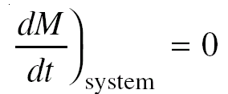

Basic laws for a system
Objective
To convert system equations of basic laws to equivalent control volume formulation. (Need to express each of the basic laws in terms of rate equations)
Conservation of mass

Slide 6
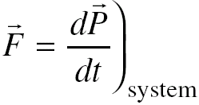

Basic laws for a system
Momentum equation for inertial control volume (Newton’s second law)

Slide 7
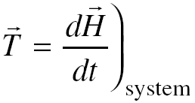


Basic laws for a system
Angular momentum principle

Slide 8
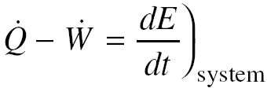

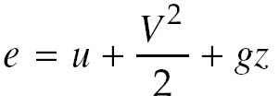
Basic laws for a system
First law of thermodynamics (Conservation of energy)

Slide 9
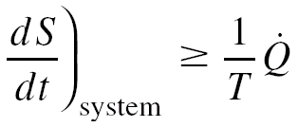

Basic laws for a system
Second law of thermodynamics

Slide 10

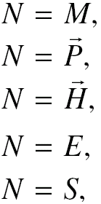
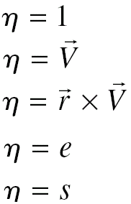
Relation of system derivatives to control volume formulation
Conversion of system rate equation into equivalent control volume formulation
Extensive and intensive properties

Slide 11
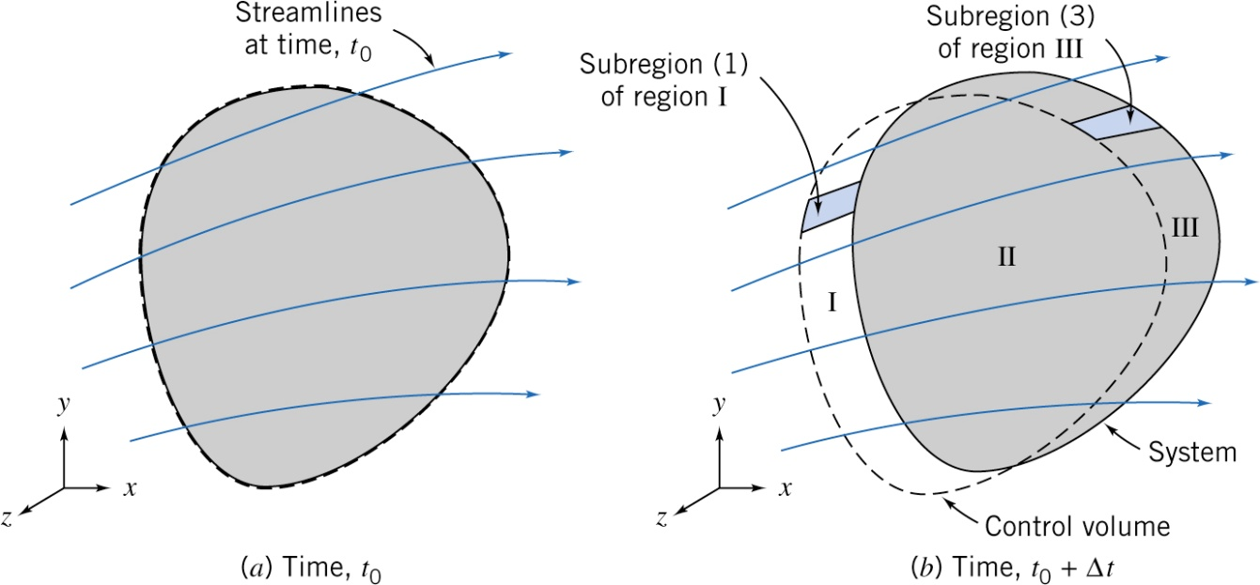
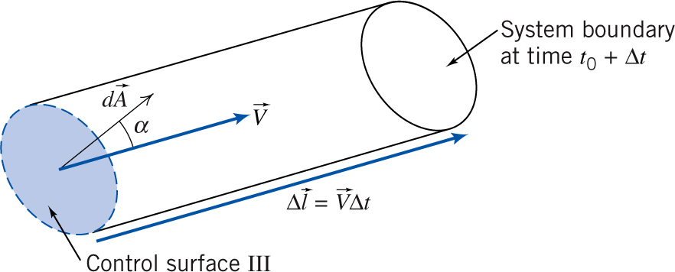
Derivation of Reynolds transport theorem
System and control volume (at different times)
Enlarged view of sub-region (III)

Slide 12
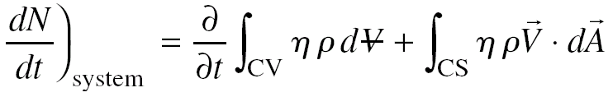
Reynolds transport theorem
Fundamental relation between rate of change of any arbitrary extensive property of a system and variation of this property associated with a control volume.

Slide 13
Reynolds transport theorem – Interpretation of terms
(1) (2) (3)
(1) → Rate of change of system extensive property
(2) → Rate of change of amount of property N in a control volume
(3) → Rate at which the property N is exiting the surface of the control volume

Slide 14
Velocity (In Reynolds transport theorem)
Evaluation of the dot product (velocity and area)
Directions of these vectors (velocity and area) should be taken into consideration while evaluating this dot product
Velocity is measured always with respect to control volume (stationary or moving)

Slide 15
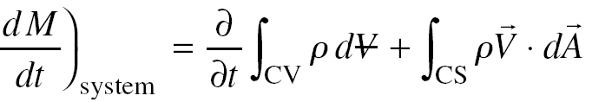
Conservation of mass
Basic law
Using Reynolds transport theorem,

Slide 16
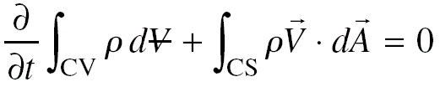
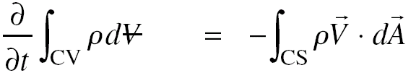

Conservation of mass
Combining basic law and transport theorem
→ Continuity equation in integral form

Slide 17


Conservation of mass – Special cases
Incompressible fluids (and non-deformable control volume)
If there is uniform velocity each at inlet and exit
Volume flow rate into the control volume must be equal to the volume flow rate out of the control volume

Slide 18


Conservation of mass – Special cases
Steady, compressible flow
If there is uniform velocity each at inlet and exit
Mass flow rate into a control volume must be equal to the mass flow rate out of the control volume

Slide 19
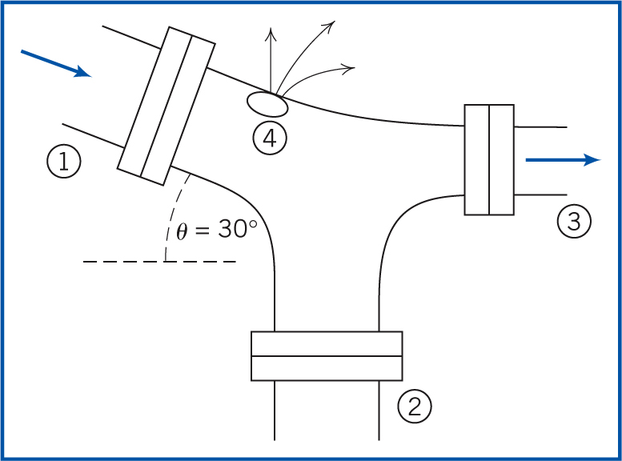
Example-1
Steady water flow at a pipe junction
A₁=A₂ =0.2 m²
A₃=0.15 m²
V₁= 5 m/s
V₃ = 12 m/s
Q₄ = 0.1 m³/s
Find V₂

Slide 20
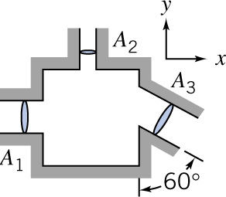
Example-2
Fluid with 1040 kgm³ density is flowing steadily through therectangular box. Given A₁=0.046 m², A₂= 0.009 m², A₃= 0.056 m², V₁= 3i m/s and V₂= 6j m/s. Determine velocity V₃

Slide 21
Example-3
Water enters a wide, flat channel of height 2h with a uniform velocity of 2.5 m/s. at the outlet the velocity distribution is given by u/u_{max}= 1- (y/h)². where y is measured from the center line of the channel. Determine the exit center line velocity.

Slide 22
Example-4

Slide 23
Momentum equation for inertial control volume
Assumption
Inertial control volume (at rest or moving with constant velocity)
Control volume coordinates → x, y, z
Absolute coordinates → X, Y, Z
Newton’s second law

Slide 24
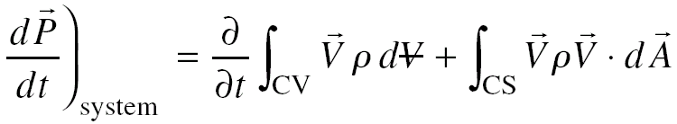
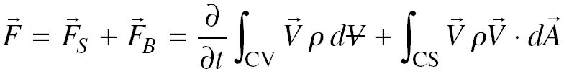
Momentum equation for inertial control volume
Using Reynolds transport theorem –
Combining basic law and Reynolds transport formulation
→ Momentum equation (Equation of motion) in integral form

Slide 25
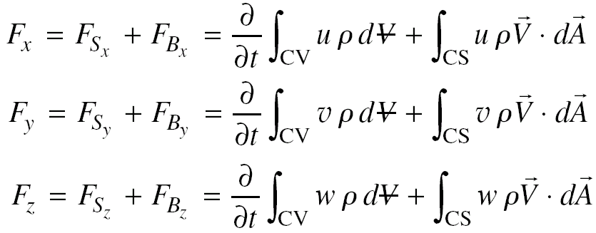
Momentum equation for inertial control volume
Momentum equation (components)

Slide 26
Momentum equation for inertial control volume – Special cases
Steady flow
First term on the right hand side becomes “zero”
Uniform velocities at inlet and outlet
Second term on the right hand side will be having summation over control surface instead of integral form.

Slide 27
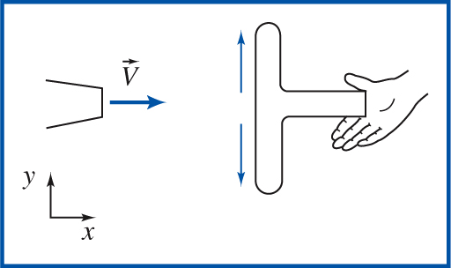
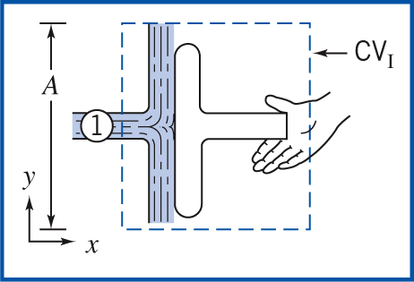
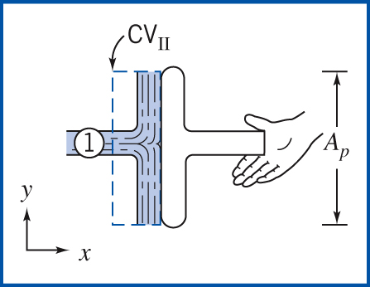
Example : Choice of control volume for momentum analysis
Water from stationary nozzle strikes a flat plate.
V₁ = 15 m/s
A_{n}=0.01 m²
Determine horizontal force
to hold it in place

Slide 28
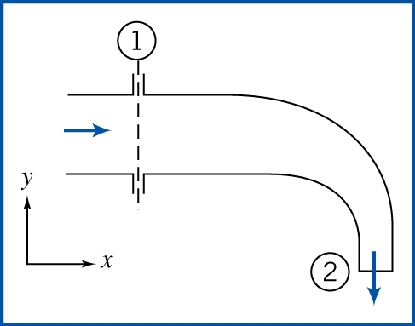
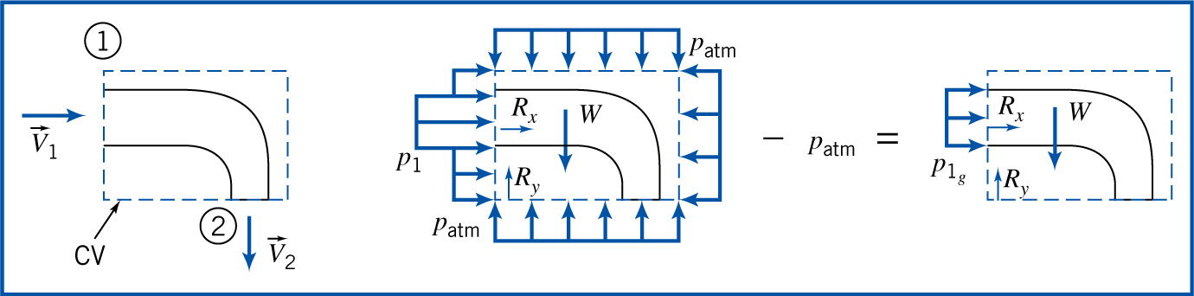
Example: Flow through an elbow (Use of gauge pressures)
Steady water flow through 90⁰ reducing elbow
P₁=220 kPa (abs); A₁=0.01 m²
A₂=0.0025 m² ; V₂ = - 16j m/s
P₂ = 1 atm (101.352 kPa) (abs)
Determine the force required to hold the elbow in place

Slide 29
Momentum equation – CV moving with constant velocity
Two coordinate systems
Absolute → XYZ (stationary → Inertial)
Coordinates attached to the CV → xyz ( moving with constant velocity → Inertial)
Velocities (in momentum equation) are measured relative to the control volume coordinates

Slide 30
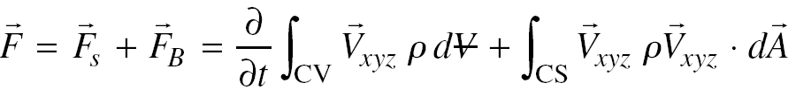
Momentum equation – CV moving with constant velocity
Momentum equation for inertial CV (stationary or moving with constant velocity)

Slide 31
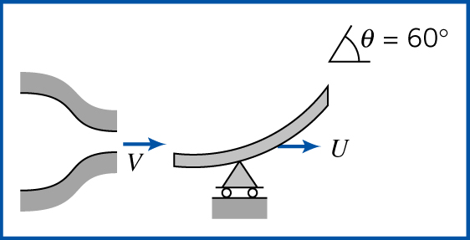
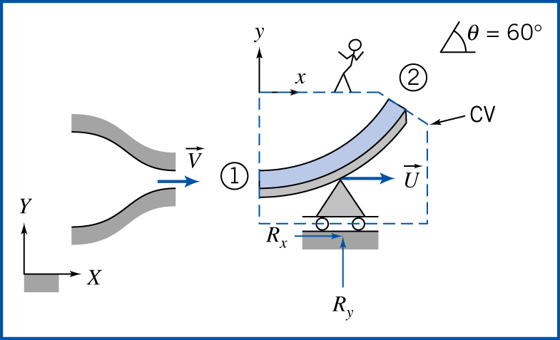
Example : Vane with moving with constant linear velocity
Vane speed (U) = 10 m/s
Speed of water coming from a stationary nozzle (V) = 30 m/s
A_{n} = 0.003 m²
Determine the force components acting on the vane

